Slide 1






Saylani Mass IT Training Presentation Task
Course Instructor
Ifra Shamim
Developed By
Sadaf Shahab
Front-End Developer & Graphics Designer
Technologies Used:

Slide 2
Automated Fee Management System
Introduction
Streamlining Fee Collection For Educational Institutions

Slide 3
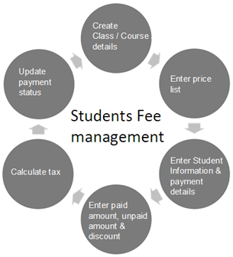
Introduction to Fee Management Systems
Why Efficient Fee Management Matters
Efficient fee management systems are crucial for educational institutions to ensure smooth operations.
They help manage student fees, track payments, and generate receipts accurately.
An automated system reduces manual errors, enhances productivity, and saves valuable time.

Slide 4

Problem Statement
Manual Fee Collection: A Time-Consuming Task
Manual fee management is time-consuming, prone to errors, and lacks transparency.
Manual Data Entry
Calculation Errors
Wasting Paper And Ink
Time-consuming

Slide 5

Challenges in Manual Fee Management
Problem Statement
Manual fee tracking leads to errors and delays.
Difficult to maintain an accurate record of payments and dues.
Time-consuming process for issuing receipts and following up with students.

Slide 6



Problem Statement
Manual Data Entry
Wasting Paper And Ink
Time-Consuming
Calculation Errors

Slide 7
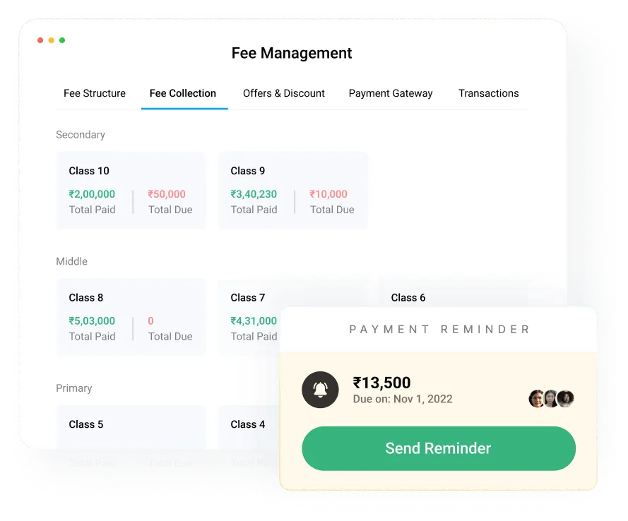
Solution Overview
Dashboard Overview
The system’s DASHBOARD is user-friendly and designed for easy navigation.
Features include:
Generate Fee Receipts
View Generated Receipts

Slide 8
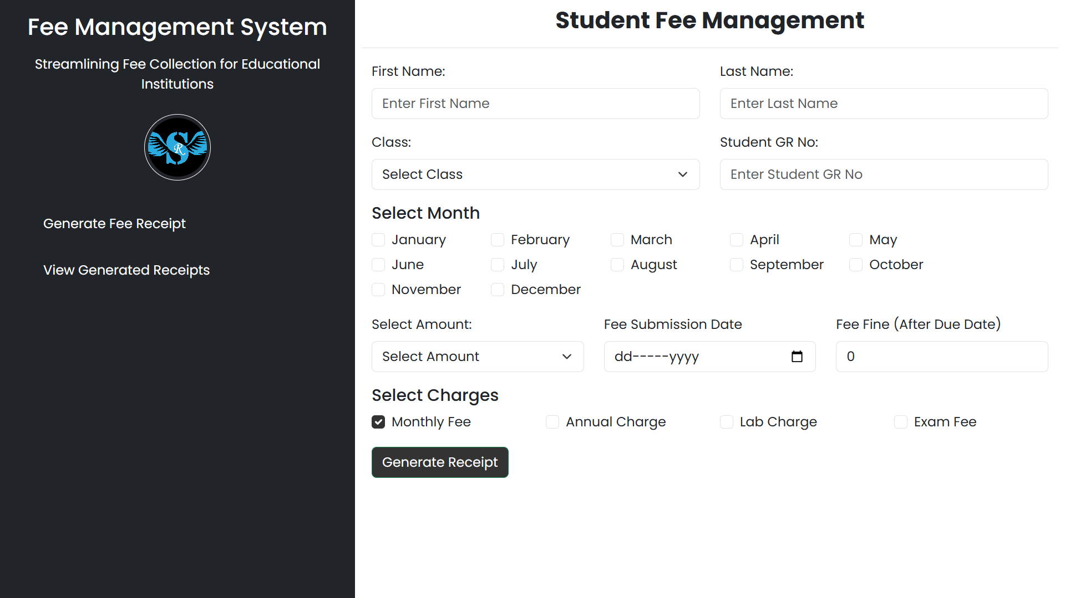
Introducing the Student Fee Management System

Slide 9
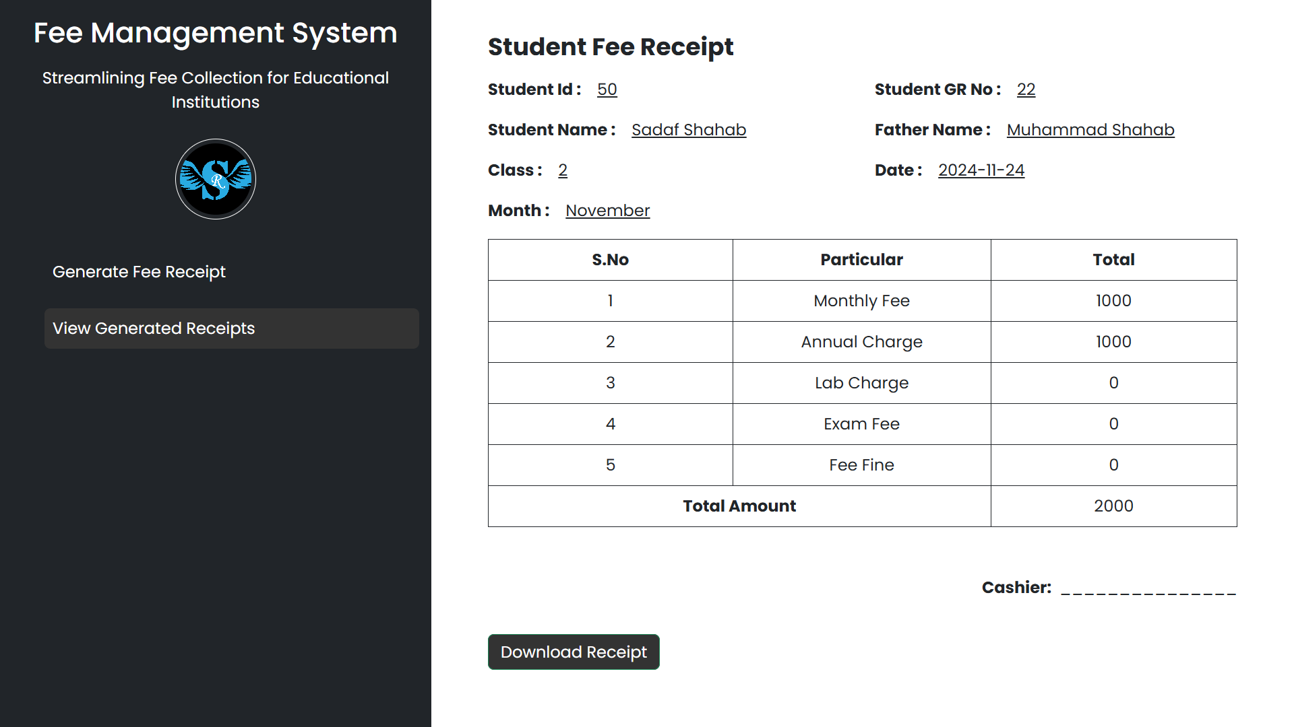
View Generated Fee Receipt

Slide 10

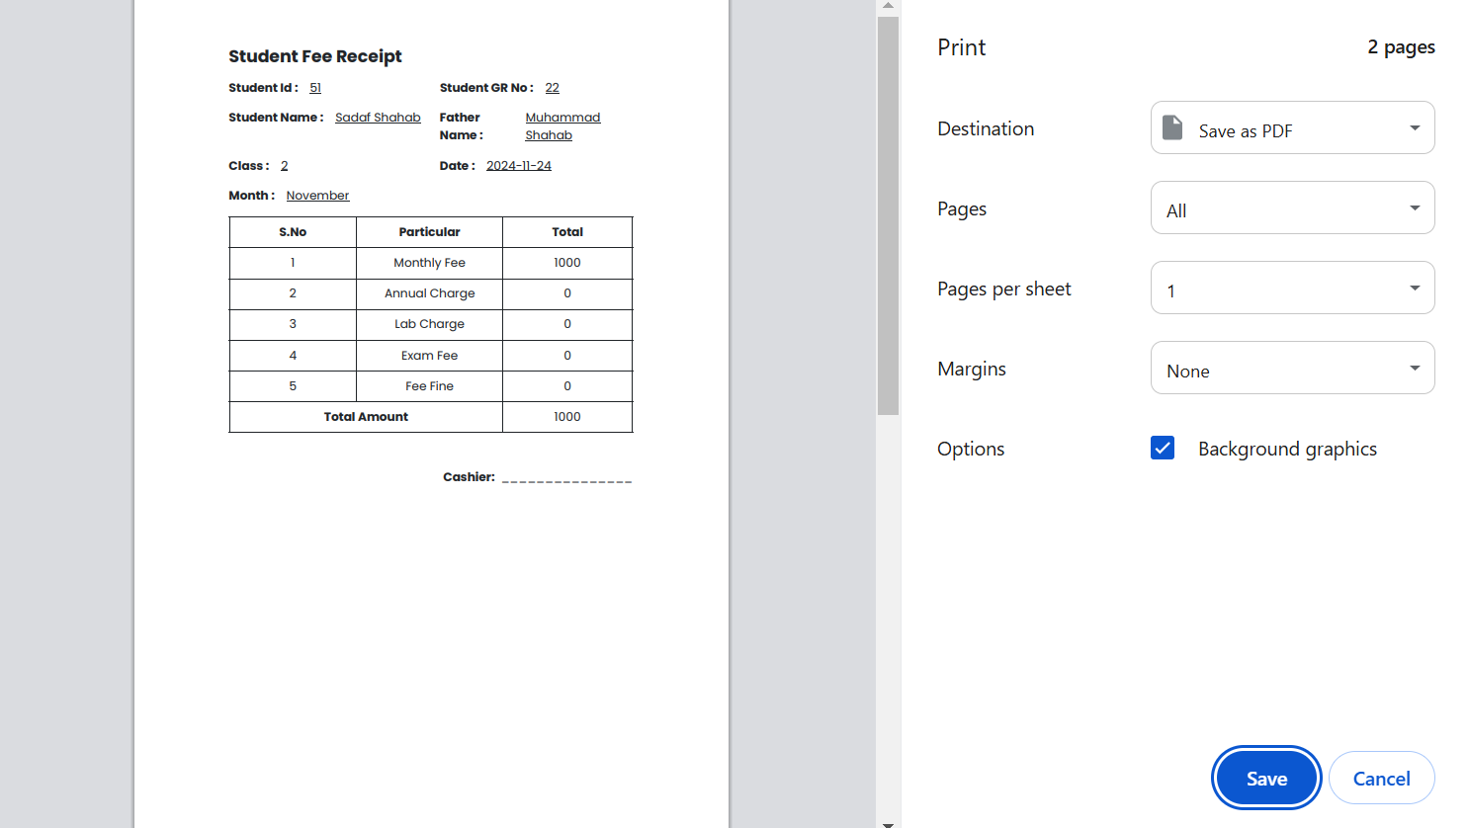
Download Receipt

Slide 11
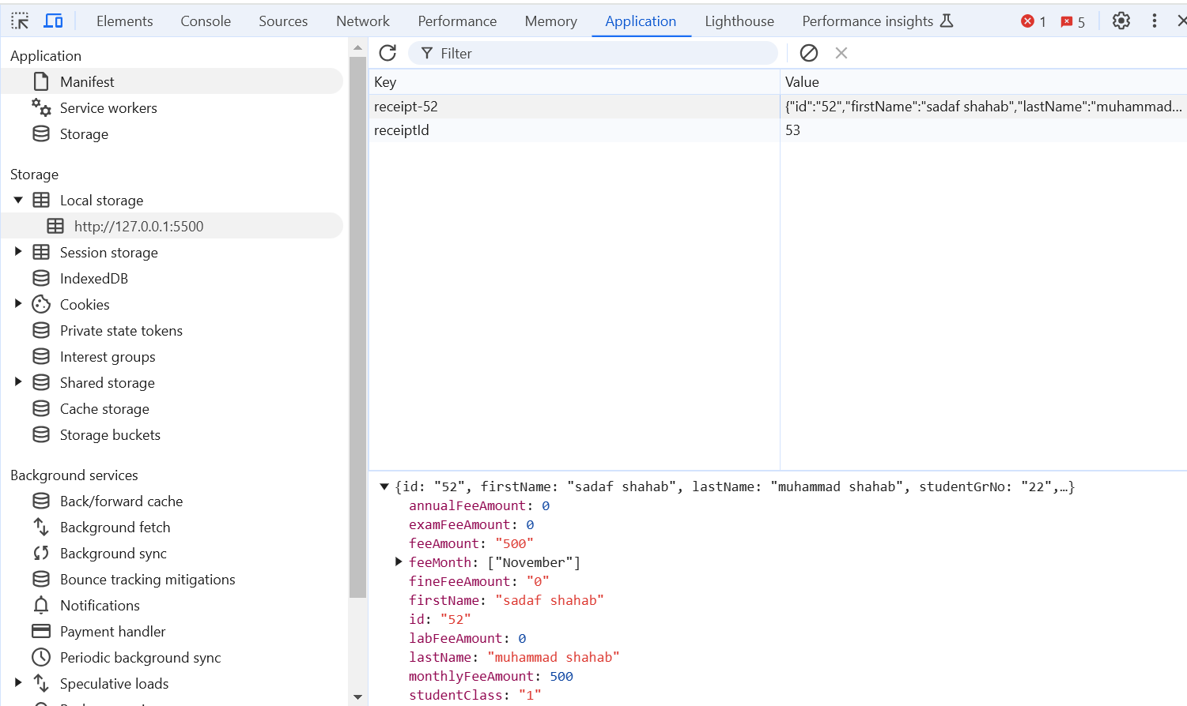
Data Stored In Local Storage You Can Watch

Slide 12





Key Features of the Automated Fee Management System
Generate receipts for individual students
Calculate total fee amount based on selected months
Download receipt
Print receipts
Record save in local storage of PC or mobile.
Send receipt to the parents.
Compatible in every browser.
You can use it in home tuition, institute.

Slide 13

Conclusion and Benefits
Efficiency: Reduces manual errors and time spent in fee collection.
Transparency: Clear fee breakdown and records.
Convenience: Users can generate, download, and view receipts anytime.
Scalability: Can easily be adopted by institutions of small sizes. Like (Tuitions)
Easy to use: Responsive UI , You can use it as like in Pc also in mobile.

Slide 14





Solution Overview
Efficiency
Save Time
Better UX
Local Storage (data stored)
Browser Compatibility
Less Time Consume

Slide 15

Embrace The Digital Transformation For Smoother Operations And Better Management.
Thank You For Your Attention!

